Slide 1

2017 ROADSHOW
Cape Town
FIRE DETECTION AND GAS SUPPRESSION

Slide 2
AGENDA
SESSION 1
08:30am | Welcome & Agenda | Laura Swart - Chairperson
 | SAQCC fire – History and Goals – 2017 registration fees
08:45am | QCTO qualifications | Christoph Vorwerk (QD partner)
09:30am | Short break
SESSION 2
09:45am | Fire Detection | Nichola Allen
10:15am | Gas Suppression | Hans Davel
10:45am | Short break
11:00am | Group Sessions | Q&A (Nichola, Hans, Brett)
SESSION 3
12:15am | Short break
12:30am | Industry related Trivia Quiz and prize giving
13h00am | Lunch

Slide 3
FIRE DETECTION
VISION & MISSION STATEMENT
To Qualify and Certify competent persons within the fire industry to ensure safe practice.

Slide 4
FIRE DETECTION
SAQCC fire is regulated under the Companies Act, Act no. 71 of 2008
1973 – S21 (incorporated association – not for gain)
2008 – S10 (reason for revised MOI)
Disciplinary code

Slide 5
FIRE DETECTION
SAQCCfire executive committee
BOD
Duncan Boyes
(Vice Chairman)
BOD
Matt Kielty
(Treasurer)
BOD
Tom Dreyer
(Chairman)

Slide 6
FIRE DETECTION
BOARD OF DIRECTORS
1475 sub-committee
Lizl Davel (Chair)
John Caird (Vice chair)
J J Scholtz (Treasurer)
D & GS sub-committee
Laura Swart (Chair)
Hans Davel (Vice chair)
Nichola Allan (Treasurer)

Slide 7
FIRE DETECTION

Slide 8
GRADING LEVELS &
REGISTRATION FEES
FIRE DETECTION
GAS SUPPRESSION
Level | Description | Cost
1 | Cabler | R 425.00
2 | Installer | R 635.00
3 | Serviceman | R 800.00
4 | Commissioner | R 950.00
5 | Designer | R 1 060.00
Level | Description | Cost
1 | Pipe Fitter | R 425.00
2 | Installer | R 635.00
3 | Service Man/Commissioner | R 950.00
4 | Designer | R 1 060.00
DUAL REGISTRATION
Should an authorised person register for more than one category (e.g. Detection and Gas) the second registration fee is R200 per annum.

Slide 9
Re-REGISTRATION FEES
FIRE DETECTION
GAS SUPPRESSION
Level | Description | Cost
1 | Cabler | R 315.00
2 | Installer | R 425.00
3 | Serviceman | R 635.00
4 | Commissioner | R 715.00
5 | Designer | R 795.00
Level | Description | Cost
1 | Pipe Fitter | R 315.00
2 | Installer | R 425.00
3 | Service Man/Commissioner | R 715.00
4 | Designer | R 795.00
DUAL REGISTRATION
Should an authorised person register for more than one category (e.g. Detection and Gas) the re-registration fee is R200 per annum.

Slide 10
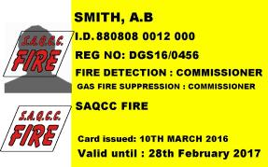
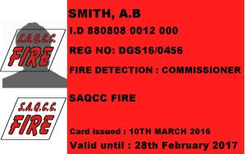
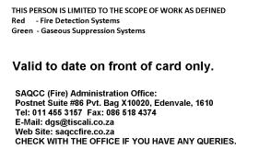
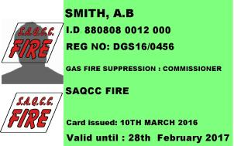
NEW CARDS
YELLOW – Fire Detection & Gas Suppression
GREEN – Gas Suppression
RED – Fire Detection

Slide 11

FIRE DETECTION
Next step: Formalise training
established in terms of the Skills Development Act. It's role is to oversee the design, implementation, assessment and certification of occupational qualifications on the Occupational Qualifications Sub-Framework (OQSF).

Slide 12

Questions

Slide 13
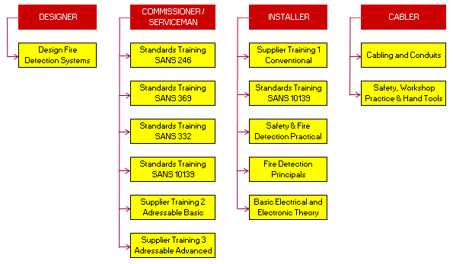

FIRE DETECTION
SAQCC FIRE – fire detection training courses

Slide 14
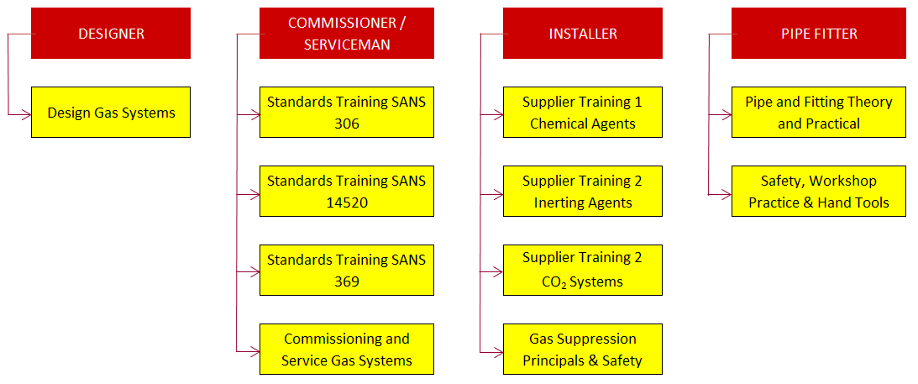

GAS SUPPRESSION
SAQCC FIRE – gas suppression training courses

Slide 15
Gas Registration
As the courses aren’t available for all of the Gas Suppression categories registration is still currently done via assessment tests.
These are arranged in the main cities throughout the year.

Slide 16
Questions

Slide 17
Fundamentals of SANS10139
Categories
Cabling
Detection applications

Slide 18
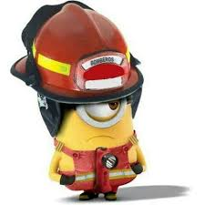
System Categories
SANS 10139 defines 8 categories of systems consisting of 3 main divisions
Manual systems (M)
Protection Life (L)
Protection of property (P)

Slide 19
Categories – Life Protection
Cat | Activation Method | Alarm Devices
M | MCP | Throughout
L5 | AFD where specified | Throughout
L4 | MCP + AFD on escape routes and escape stairways only | Throughout
L3 | MCP + AFD as L4 + AFD in rooms opening onto escape routes* | Throughout
L2 | MCP + AFD as L3 + AFD in other areas of high fire risk | Throughout
L1 | MCP + AFD throughout | Throughout
* AFD in escape routes should be optical smoke or CO mix

Slide 20
Category – Property Protection
Cat | Activation Method | Alarm Devices
P1 | AFD Throughout | Where required
P1/M | AFD Throughout + MCP | Throughout
P2 | AFD where specified | Where required
P2/M | AFD where specified + MCP | Throughout

Slide 21
Selection of Category
Who decides which category to use?
Building designer
Building control body
Local fire authority
Fire safety consultant
Fire risk assessor
NOT the fire alarm contractor

Slide 22
Guidance on Choosing a Category
Still important to have an awareness of the appropriate system category
SANS10139 Annex 1
Provides examples of typical buildings and generally used system category
This is informative only and is based on the general interpretation of the standard

Slide 23
SANS10139 Annex 1
Type of Premises | Typical Category | Comments
Common places of work- offices, factories, warehouses, shops, restaurants | M or P1/M or P2/M | M normally suffices Combined with P1 or P2 to satisfy insurers or business continuity
Hotels and Hostels | L1 or L2 | Usually based on L3 but with many additions resulting in at least L2 but normally L1
Hospitals | L1 | Refer SANS322
Prisons | M or P2 or L4

Slide 24
SANS10139 Annex 1
Type of Premises | Typical Category | Comments
Schools greater than 160 pupils | M or M/P2 or M/P2/L4 | L4 generally if evening classes held
Places of assembly – cinemas, museums, theatres, nightclubs, casinos | M if less than 300 people L1 – L4 for larger | L1 for large complex buildings with high evacuation risk
Covered shopping centres | L1 – L3 | Normally a tailor made engineered solution
Residential care homes | L1 – L3 | L1 for large homes

Slide 25
Fire Cable Requirements
Fire Resistance
continue to operate in a fire for a specified time
maintain circuit integrity
Fire Propagation
self-extinguishing
not act as transmission medium for fire
Emission of Fumes & Gases
low emission of clear fumes
Without halogens (corrosive gases)

Slide 26
Fire Cable Requirements
All cables for the Critical Signal Paths and the final mains supply should be tested for resistance to fire, shock and water spray (SANS 50200). They should also be low smoke/zero halogen (non-toxic.
Standard resistance fire cable
(a 30 min survival time at 840ºC)
Enhanced resistance fire cable
(a 120 min survival time at 840ºC)

Slide 27
Fire Cable Requirements
Minimum 1mm² cross sectional area for all conductors
All fire alarm cable should be red in colour
Should include the following markings:
the manufactures name, trade name
the year of manufacture
the cable description
the fire rating of the cable along with the test method used
the batch number

Slide 28
Standard or Enhanced?
Standard
Enhanced
Unsprinklered buildings that are:
Less than 30m high
Less than 4 stage evacuation
Unsprinklered buildings that are:
Over 30m high
More than 4 stage evacuation
Delayed evacuation areas
Specified high risk areas

Slide 29
Cable Supports
Protection may be provided by:
Laying cable on tray
Burying it in the structure of the building
Installing in steel conduit, ducting or trunking
PVC conduit supports (non-combustible) and distance between supports does not exceed 500mm
Supports must be non-combustible and withstand similar temperature and duration as the cable
NB!! Plastic clips, cable ties, trunking not suitable

Slide 30
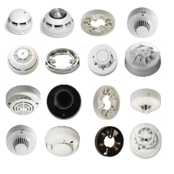
Automatic Detection
Heat
Smoke
Combustion Gas (such as carbon monoxide)
Infra-red or ultraviolet radiation

Slide 31

Heat
Point type temperature detectors
Different Classes, temperatures, fixed temperature and Rate of Rise (RoR)
Linear Heat Cable
Temperature Probe
Notes:
Heat detectors are generally less sensitive to most fires, as they need to sense significant heat, however they can be useful in detecting clean burning fires that don’t produce smoke. They can be useful in environmental conditions where other detectors would create false alarms, eg kitchens, boilers, car parks.

Slide 32
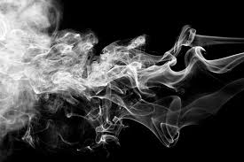
Smoke
Point detector – optical or ionisation
Optical beam detectors
Aspirating smoke detectors

Slide 33
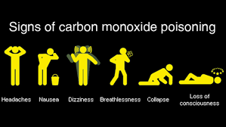
Combustion Gases
Carbon monoxide detectors (CO)
Multi-criteria detectors

Slide 34
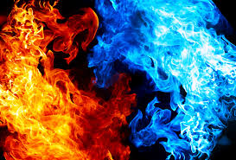
Infra-red or Ultraviolet Radiation
Flame detectors
Ember detectors

Slide 35
DETECTOR SELECTION
Protected/Type of area
Hotel bedroom, office, kitchen, corridor, workshop
Predominant use of area
Sleeping, cooking, office work, storage, manufacturing
Fire risk
Smouldering smoke (white/dark), flaming (clean/dirty)
False alarm risk
Steam, toaster/oven, dust, smoking, hot works

Slide 36
DETECTOR SELECTION

Slide 37
DETECTOR SELECTION

Slide 38
DETECTOR SELECTION

Slide 39
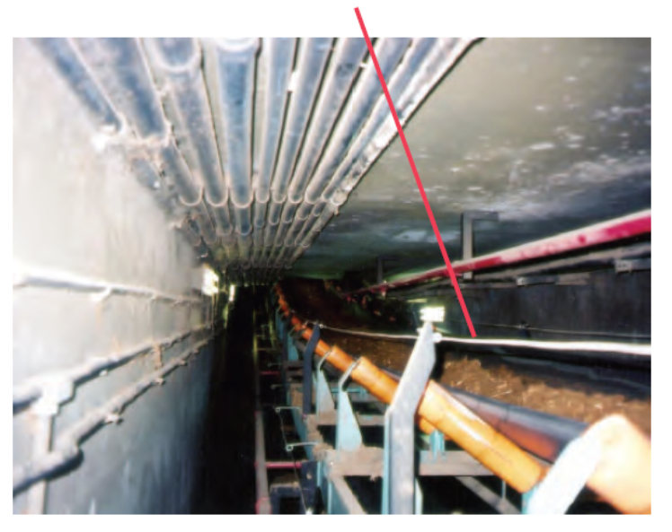
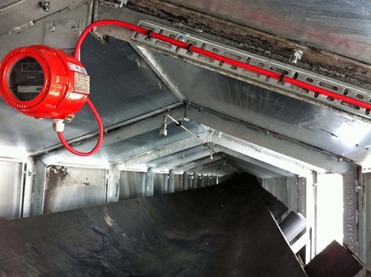
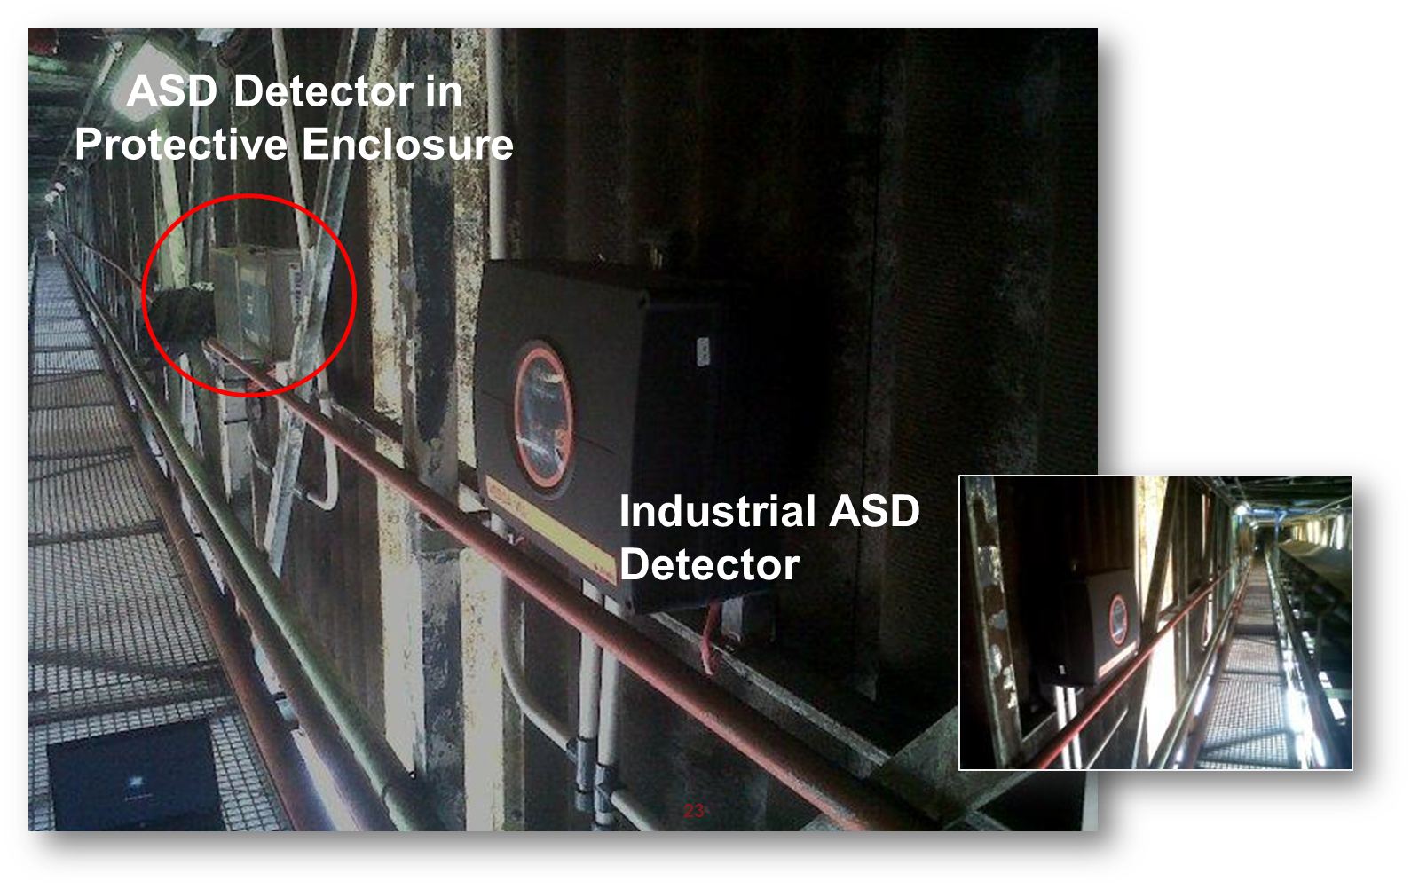
EXAMPLES – CONVEYOR PROTECTION
Linear heat cable
Flame detection
ASD detection

Slide 40
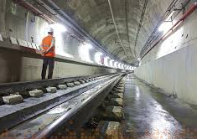
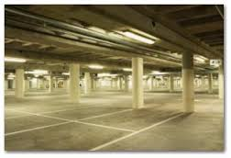
EXAMPLES – INDUSTRIAL
Linear heat cable – car parks/tunnels
Industrial ASD detection

Slide 41
EXAMPLES - WAREHOUSES
ASD

Slide 42
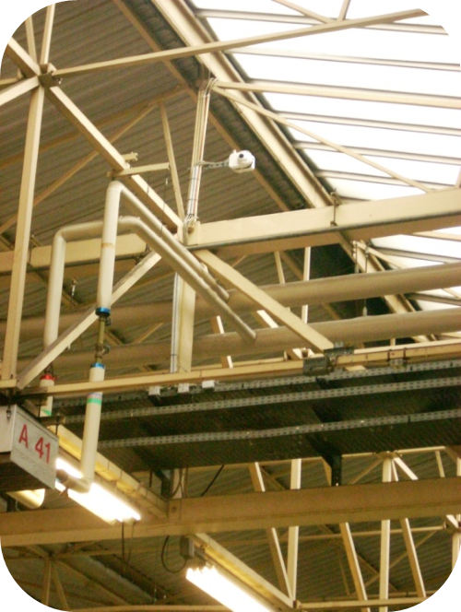
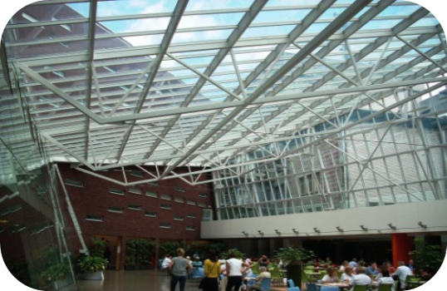
EXAMPLES – WAREHOUSE, ATRIUMS
Optical beam

Slide 43
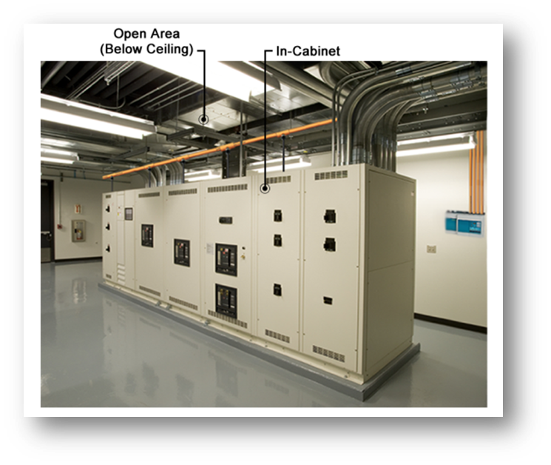
EXAMPLES – ELECTRICAL CONTROL, SWITCHGEAR
ASD – In cabinet, AHUs

Slide 44
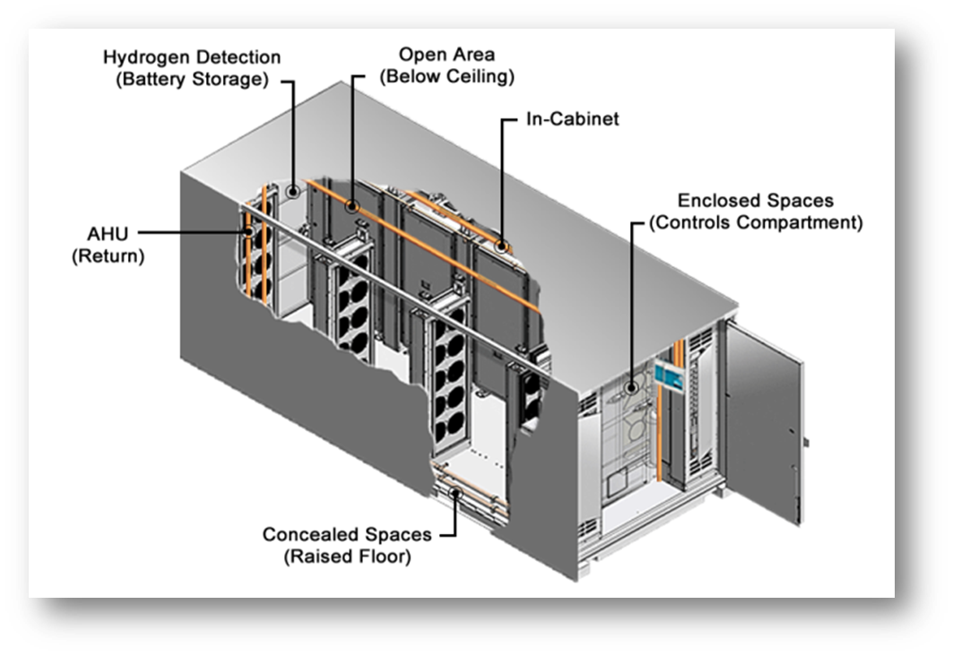
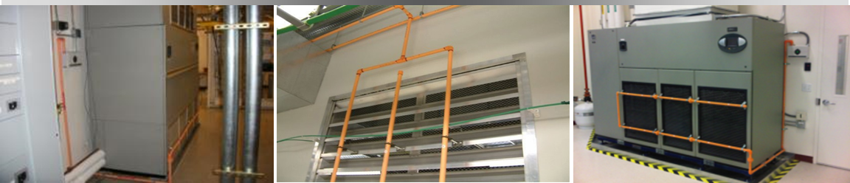
EXAMPLES – DATA CENTERS
ASD – In cabinet, AHUs, open area

Slide 45
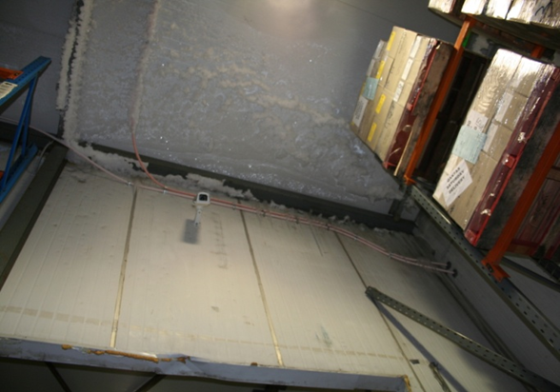
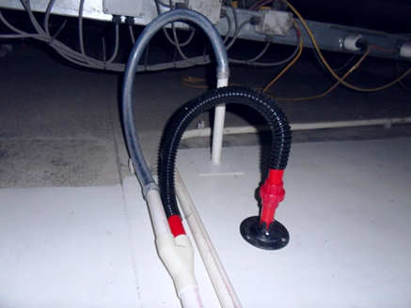
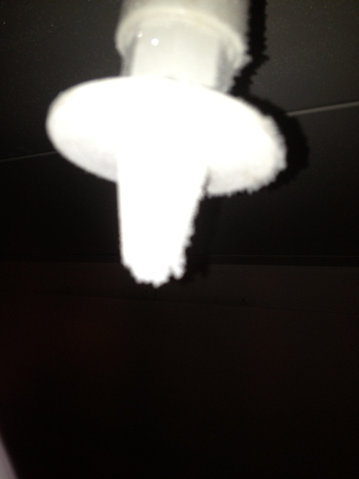
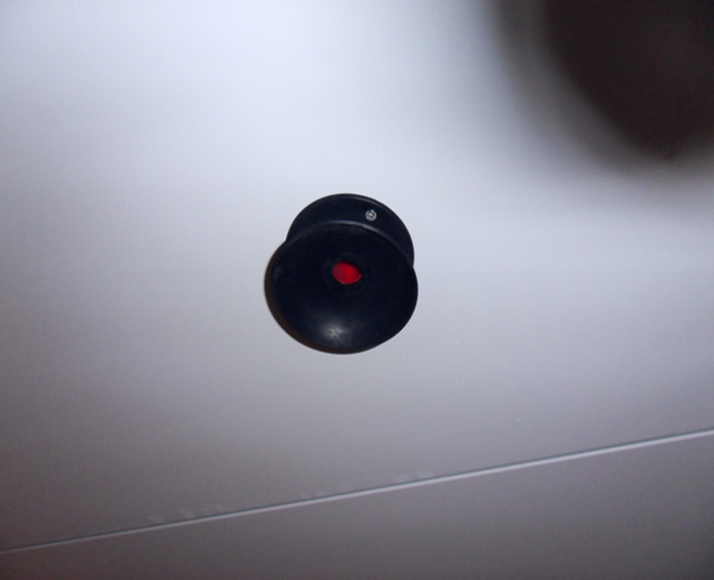
EXAMPLES- FREEZER ROOMS
Standard ASD Sampling Point
Cold Storage Sampling Point

Slide 46
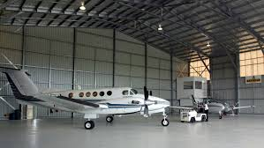
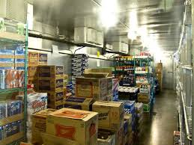
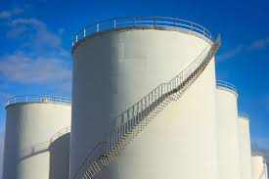
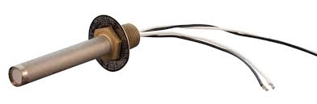
EXAMPLES – FLAMMABLE LIQUIDS
Flame Detectors
Linear heat cable or heat probe

Slide 47
Questions

Slide 48
GAS SUPPRESSION

Slide 49
Questions

Slide 50

GROUP SESSION

Slide 51
Questions

Slide 52

20 QUESTIONS

Slide 53
Round 1 - Standards
What standard offers the code of practice for the operation of fire protection for actuation of gaseous total flooding extinguishing systems?
What standard covers fire detection for hospitals?
What is the maximum floor area of a single zone containing conventional automatic fire detection?
How often should a fire detection system be serviced?
Name 3 documents that must be provided in a system handover.

Slide 54
Round 2 - Detection
Where should the EOL resistor be fitted on a conventional zone?
Can you use an aspirating unit as a control panel?
What reading is used on addressable detection to determine the smoke or heat level of a point detector?
Which type of detector is best in an aircraft hanger?
Why type of detector is best in cold storage?

Slide 55
Round 3 – Gas Suppression

Slide 56
Round 4 - SAQCC
SAQCC is responsible for registering what?
SAQCC runs training courses? True/False
SAQCC is a non-profit organisation? True/False
What is the SAQCC website address?
SAQCC runs awesome roadshows? True/False

Slide 57
THANK YOU

